Slide 1

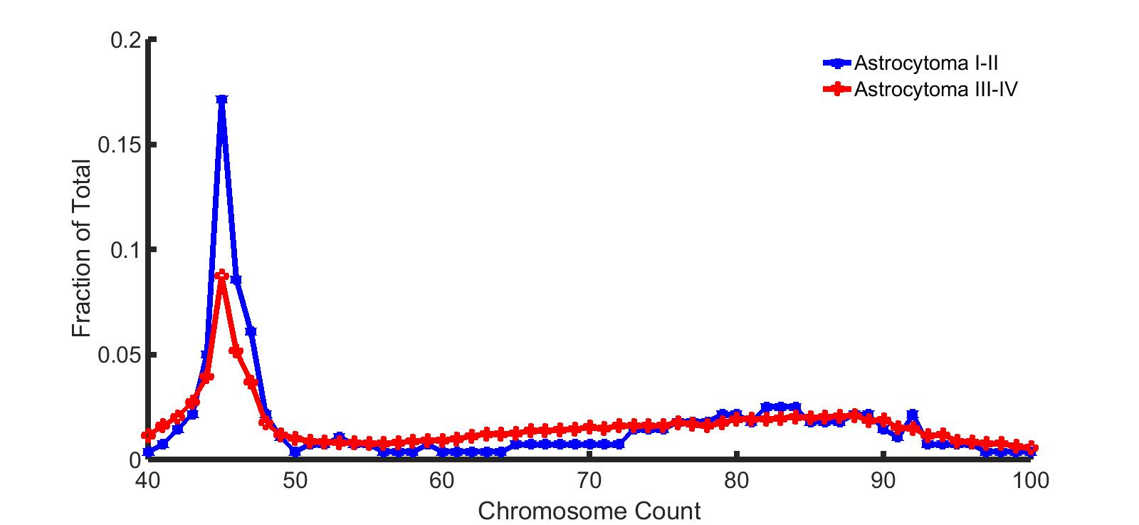
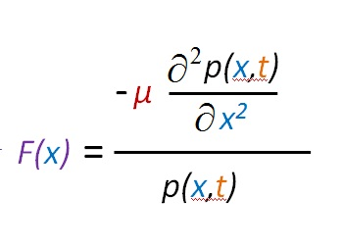
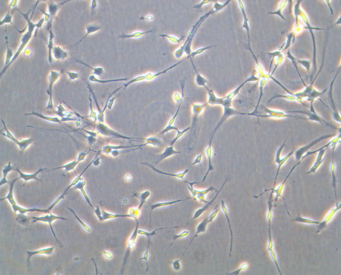
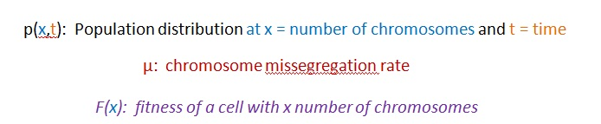
Tetraploidy revealed as an obligate precursor to CIN using fitness landscape modeling
Kelly Brock, Andrew Chen, Marianna Kleyman, Kristina Godek, Duane Compton, and Arijit Chakravarty
DMPK, Takeda Pharmaceuticals International Co., Cambridge, MA, USA
Dartmouth University, Hanover, NH, USA
BACKGROUND
Figure 1
Glioblastoma data illustrates heterogeneity in chromosome copy number
Figure 2
Modeling CIN through diffusion and growth
Up to 90% of solid tumors display chromosomal instability (CIN), which is defined by an increased missegregation rate that can lead to a heterogenous population of aneuploid cells. Tumors that display CIN tend to be more resistant to certain treatment regimens and are overall associated with a poorer patient prognosis.
A.
B.
METHODS
To model how chromosome counts can shift over time, we use a partial differential equation that contains a diffusion term corresponding to chromosome missegregation and a growth term proportional to the relative fitness of a particular chromosomal distribution. Using this framework, a fitness landscape that connects chromosome count to relative fitness can be inferred from a steady-state cellular population. Fluorescence in situ hybridization (FISH) was used to track chromosome counts in both CIN and non-CIN cell lines over the course of 2 months, with data collected for chromosome 10 individually and for the group of chromosomes 1, 5, and 19. Experimental results were then analyzed using our mathematical framework to determine fitness landscapes for both CIN and non-CIN cells.
Brain tumors in humans have different manifestations that can result in different prognoses. In particular, astrocytomas can be grouped from I-IV, with stage 4 (glioblastoma multiforme) having both the latest onset and the worst prognosis on average. For all cases, chromosome counts appear to be roughly bimodal, with greater heterogeneity associated with later-stage disease.
A) A simple partial differential equation can be used to model how chromosomal count changes in cells with differing CIN levels. B) If steady-state conditions hold, the underlying fitness landscape can be derived from experimentally-determined aneuploidy levels.
Figure 3
Spectral karyotyping can give CIN-based chromosome distributions
Figure 4
Fitness landscapes reveal that passing through an intermediate tetraploid state allows CIN to arise without incurring severe fitness cost
A.
B.
A.
B.
RESULTS
A) Example of fitting either a normal (Gaussian) distribution or a Gaussian extreme value (GEV) distribution to chromosome histograms. B) CIN lines are better fit by normal distributions on average, p = 0.0437.
A partial differential equation was developed to model how chromosome counts change over time based on a diffusion-like term corresponding to lagging chromosome rate and a growth rate based on a chromosome count’s contribution to overall cellular fitness.
The CIN lines exhibited chromosome count distributions that were statistically closer to normal distributions than non-CIN lines.
When connected to our mathematical model, these distributions imply that the CIN lines have a flatter fitness landscape than their non-CIN counterparts. This finding reinforces the notion that CIN lines are tolerant of highly varying degrees of aneuploidy.
C.
D.
Figure 5
Average optimal fitness occurs at triploid state
CONCLUSIONS
CIN tumors may be more resilient to treatment with taxanes and other microtubule or mitotic targeting drugs. The flatter fitness landscapes associated with CIN provide an explanation for why these drugs are less effective, since increasing or decreasing the number of chromosomes in a CIN line does not lead to a relatively large change in fitness. These findings provide a novel method of planning treatments for CIN cancers that do not depend solely on affecting mitotic fidelity.
Chromosome distributions at given timepoints for: A) HCT116 (1st trial), non-CIN; B) RPE1, non-CIN; C) U20S (1st trial), CIN; D) U251 (1st trial), CIN. Different colors represent different timepoints in days.
The difference in CIN versus non-CIN lines is emphasized by the fitness landscapes (a mapping from chromosome count to cellular survival and reproductive advantage) predicted by the model using steady-state distributions. Non-CIN lines are predicted to have a steep drop-off in fitness as chromosome count increases above euploidy.

